Slide 1
Discussion 12
Databases and Joins

Slide 2
Learning goals
Review on basic methods for databases
INSERT INTO, UPDATE, DROP, CREATE, SELECT, SET…
Building a database model:
Integer reference pattern, different types of keys, building relationships
Work on different Joins

Slide 3
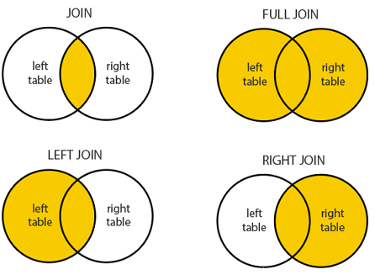
JOIN operation
Across different tables in the database
Leveraging the connections (e.g., foreign keys)
Different types of joins

Slide 4
JOIN operation
(INNER) JOIN: Returns records that have matching values in both tables
LEFT (OUTER) JOIN: Returns all records from the left table, and the matched records from the right table
RIGHT (OUTER) JOIN: Returns all records from the right table, and the matched records from the left table
FULL (OUTER) JOIN: Returns all records when there is a match in either left or right table

Slide 5
JOIN Operation
SELECT <What you want to see>
FROM <One table>
JOIN (one of the join methods) <Another Table>
ON <Attribute from one table> = <Attribute from the other table>

Slide 6
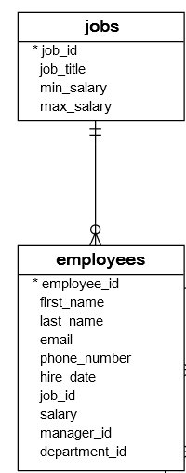
Time to practice!
In this task, you need to assist a start-up to set up their database (HR.db).
You also need to figure out some mistakes in the data provided to you (e.g., wrong salary).

Slide 7
Working with employment database
(Ignore the sql_sequence table)
You are now hired by HR department at our university to deal with an employment database.
There are two tables in the database:
Job table (job_id, job_title, min_salary, max_salary) - provided to you in HR.db
Employee table (employee_id, first_name, last_name, job_id, hire_date, salary)

Slide 8
Task 1 - Create table
What is the primary key?
Datatype for each attribute?
Employees table (employee_id, first_name, last_name, job_id, hire_date, salary)

Slide 9
Task 1 - Add employee’s information
A .json file including employee’s information as a list of dicts has been provided to you. Please add their information into the Employee table.

Slide 10
Task 2 get job and hire_date information from two tables
Before coding, let’s think about these questions:
What are the linked keys (columns) among the two tables?
Complete the following task:
Select hire_date from Employees and job_title from Jobs table and join them on job_id (INNER JOIN).
Return the job title at the earliest hire date
Expected return: President

Slide 11
Task 3 Identify problematic data
Return a list of tuples of employee’s first name and last name, whose salary does not fall into the expected salary range (min_salary - max_salary).
Expected returned list:
[('Valli', 'Pataballa'), ('Diana', 'Lorentz'), ('Nancy', 'Greenberg'), ('Ismael', 'Sciarra')]

Slide 12
Task 4 Visualize problematic data
Draw a scatter plot, whose x-axis is the job title, y-axis is the salary.
Each data point shows the salary of one employee.
Then use red “x” to show the upper and lower bound of salary for each job.
T

Slide 13
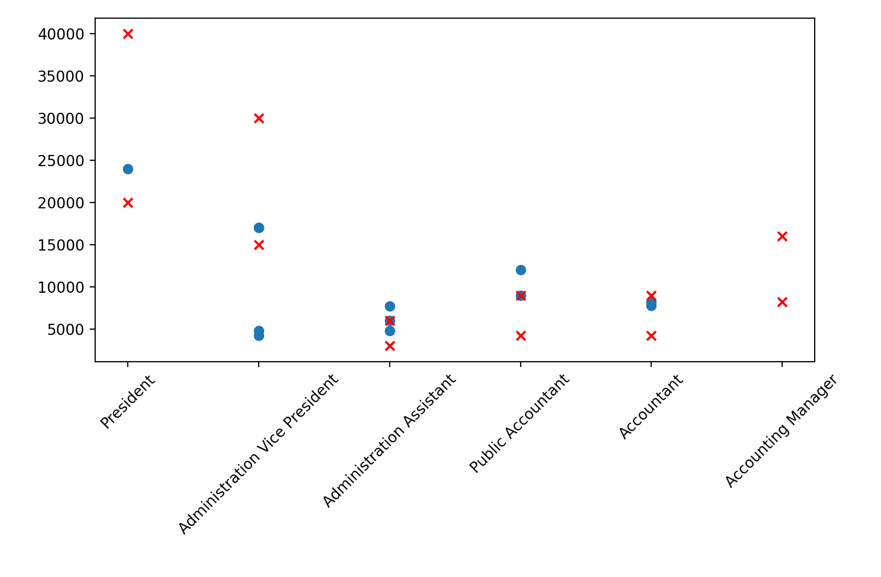
Task 4 Visualize problematic data

